Slide 1
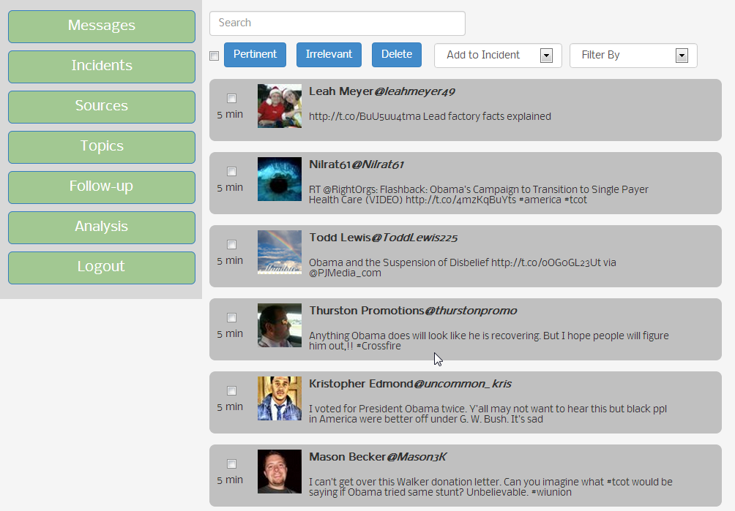
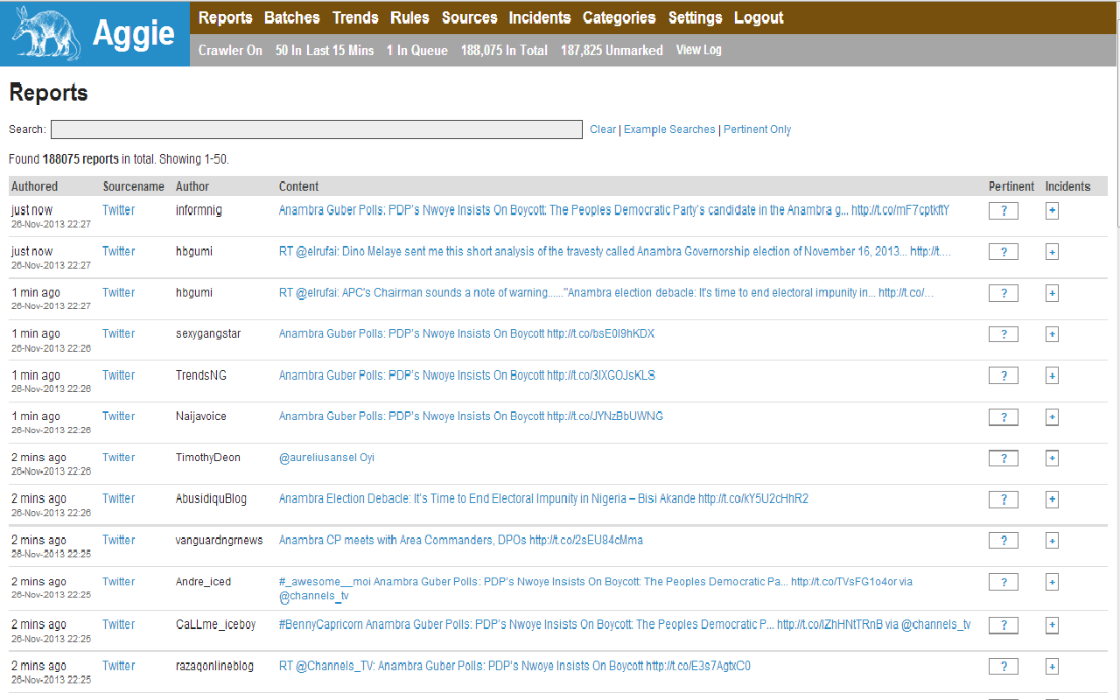
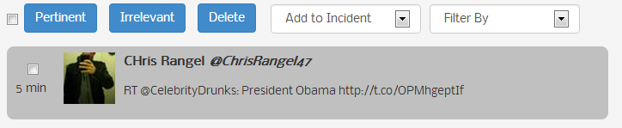
Aggie 2.0
Social Election Monitoring
What is Social Election Monitoring?
Functionality
Aggie 2.0
A method of monitoring elections in which untrained citizens report what they see during an election period using digital technology.
Unlike formal election monitoring, it does not use institutionalized procedures. Any citizen can report problems, which will then be tracked in near-real-time.
After Aggie 1.0's use in the 2012 Ghana elections, focus groups were conducted to see what was working and what was not. The users raised a number of concerns which have influenced the design of 2.0:
1) Ease of Learning – Users should easily be able to locate the functions and know how they are used.
2) Performance – Aggie should not lag or crash.
3) Who is Doing What – Unclear who created incidents; Links to reports and trend bars do not change color after being clicked on, leaving the user with very little feedback.
Basic usage
Users register on the website
On login, the user sees the messages pages which contains feed from Twitter, Facebook and RSS Feeds.
These feeds are configurable to specific search terms
Aggie 1.0
Aggie 1.0 is a web application that is used in a Social Media Tracking Center (SMTC) to monitor elections. It uses crowdsourcing to aggregate information from Facebook, Twitter, and RSS feeds based on user-defined keywords.
On election day, social election monitors in the SMTC examine reports as they are received and communicate any important findings to the necessary resonse units (e.g., election management body, police department, emergency services).
Auto refreshing Feed Content
Future Considerations
Advanced user actions
Users can flag off certain feed items as incidents.
Can mark feed items as pertinent or irrelevant to an incident.
Can start search bots on new search terms.
Incorporating an SMS function.
Building a mutual understanding of Aggie's functionality prior to election day.
Mark item as pertinent/ irrelevant
Software Technologies
Select specific feed items
Create Incidents
Filter items by Incident
Node.js and Express to create a scalable backend.
jQuery and HTML5 to create a dynamic auto refreshing front end.
CS 4803/8803; INTA 4803/8803 - Democracy and the Internet
Nataraj Kaushik (nmocherla3@gatech.edu), Siddharth Choudhary (siddharthchoudhary@gatech.edu), Ses Goe (ses.goe@gatech.edu), John Hale (jhale9@gatech.edu), TJ Strott (tstrott@gatech.edu)
Notes:
1

